Slide 1
Cristian Varela Snr. Data Architect @ Aon Centre of Innovation and Analytics (ACIA) cristian.varela@aon.ie
Open Source Real Time Pipelines with StreamSets

Slide 2
Content
Who Am I?
StreamSets Overview
StreamSets Data Collector
Installation & Minimum Requirements
SDC Management UI
Pipelines Design
SDC Designer UI
Step by Step Pipeline Creation
Running Pipelines
Resetting Origins
View Flowing data with Snapshots
Previews
Error Handling
In Depth
SDC Expression Language
SDC Expression Functions
Branching, Splitting & Merging
Pipeline Configuration
Event Generation
Whole File Processing
Advanced Topics
MicroService Pipelines
RESTful API
Notifications & Alerts
Secrets Managers
Jython Processor
RPC
Installing Libraries
Enterprise Features
Notes:
Lightweight Exec Engine that streams and process data in real time.
A pipeline is a set of “Stages” that represent the “Origin” and “destination(s)” of the data as well as any additional intermediate processing.

Slide 3
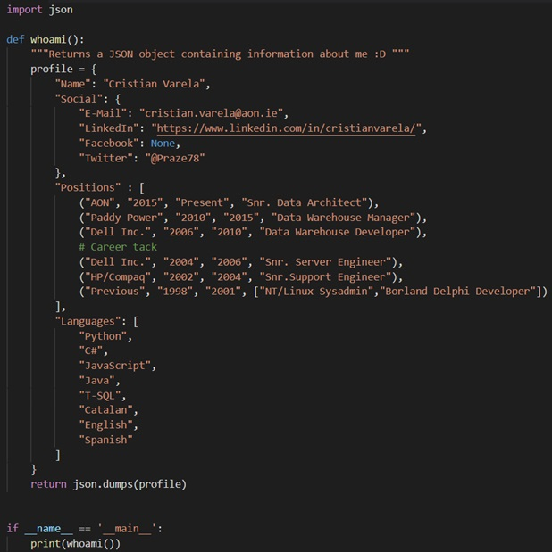




whoami.py
Views are my own and do not
represent the opinions of my
employer

Slide 4
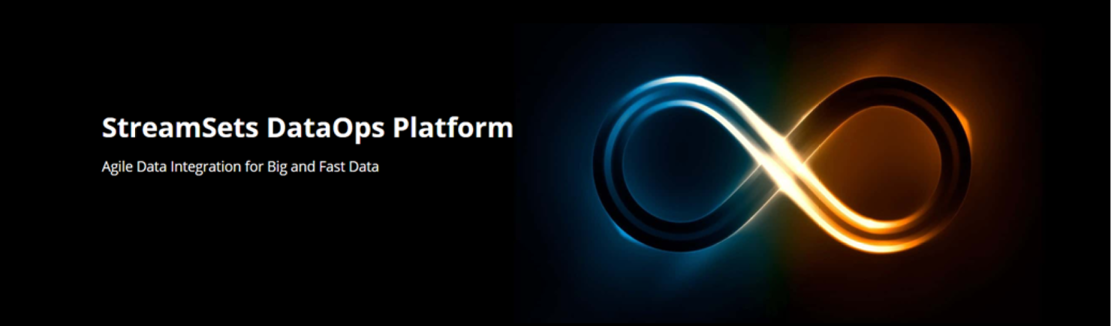
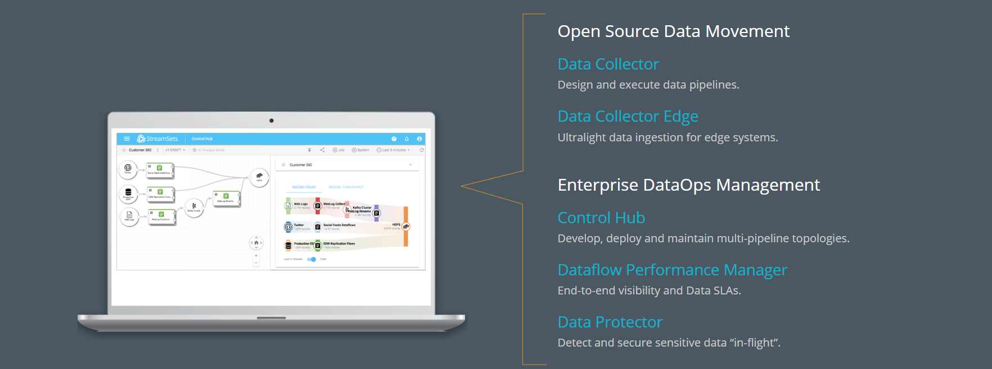
What is StreamSets?
Visit streamsets.com for further details
Notes:
Commercial Platform with couple of Open Source Components

Slide 5
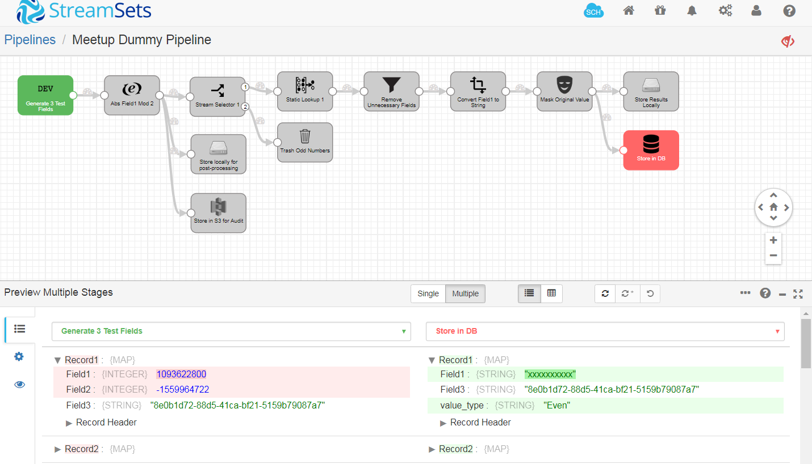
StreamSets Data Collector
StreamSets Data Collector is a low-latency ingest infrastructure tool that lets you create continuous data ingest pipelines using a drag and drop UI within an integrated development environment (IDE).
bit.ly/2SEFCVd >> StreamSets Docs / Getting Started
Notes:
Lightweight Exec Engine that streams and process data in real time.
A pipeline is a set of “Stages” that represent the “Origin” and “destination(s)” of the data as well as any additional intermediate processing.

Slide 6
Data Collector Installation & Minimum Requirements
https://streamsets.com/opensource
For Iot Devices install Data Collector Edge
Component | Min. Requirement
OS | Mac OS X CentOS 6.x / 7.x RHEL 6.x / 7.x Ubuntu 14.04 / 16.04 LTS
Cores | 2
RAM | 1GB
Disk Space | 6GB
JVM | Oracle Java 8 / OpenJDK 8
Browser | Chrome / Firefox / Safari
Component | Min. Requirement
Platform | Darwin AMD64 Linux AMD64 Linux ARM v6/7/8
Offers limited number Sources, Processors & Destinations with additional restrictions compared to the Full Data Collector.
Further info: bit.ly/2GZgXtg
Full installation instructions: bit.ly/2GZ8SVu
Notes:
Data Collector Edge:
HTTP in/out
MQTT in/out
Kafka Out
WebSockets
JavaScript Evaluator
TensorFlow Evaluator

Slide 7
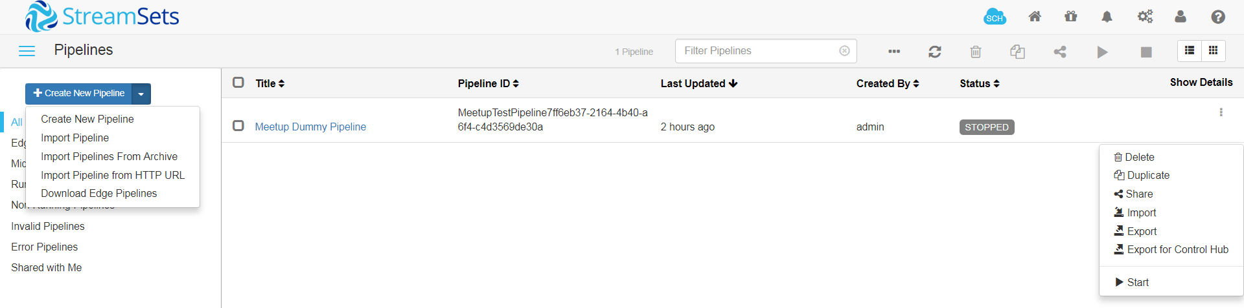
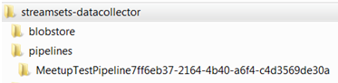
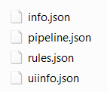
SDC Management UI
SDC Administration
Package Manager
SDC Mgmt. Home
SDC Notifications
Control Hub
Current User Info
Data Collector Menu
Pipeline Actions
New Pipeline Options
Pipelines Details
Filters
Pipeline Context Menu
Pipelines are stored in the SDC as a set of JSON files

Slide 8
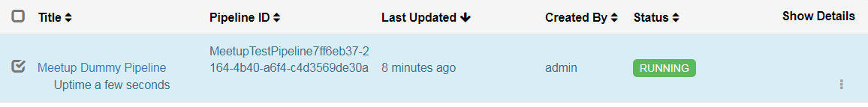
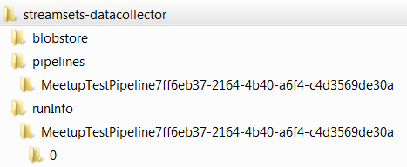
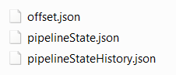
Pipelines Design in StreamSets
Describe the flow of data from the origin system to destination systems and defines how to transform the data along the way.
When you start a pipeline, the Data Collector runs the pipeline until you stop it or shutdown the Collector
You can also run pipelines in batch mode – depending on the source (scheduled or ad-hoc)

Slide 9
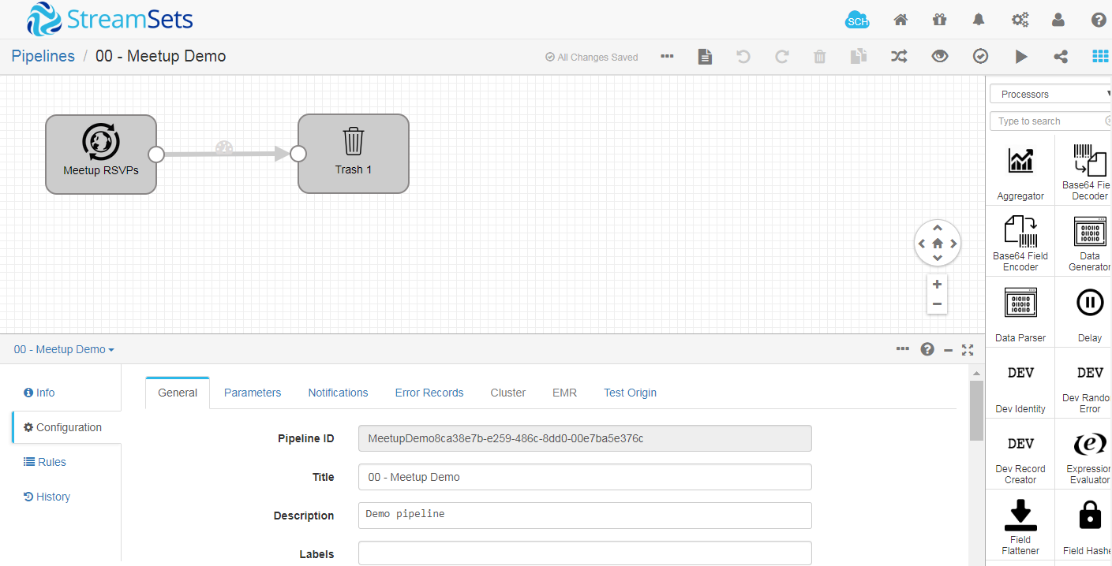
Pipeline Designer UI
Additional Pipeline Actions
View Log
Undo / Redo / Delete
Duplicate Stage
Auto-Arrange
Run Preview
Validate
Start
Share
Toggle Stage Libraries
Canvas
Stage List
Stage Libraries
Properties Panel
Notes:
Canvas: Use to configure the data flow.
Stage List: Select Stage to Configure.
Properties Panel: To configure a Pipeline or Stage.
Stage Libraries: List of available Stages.

Slide 10
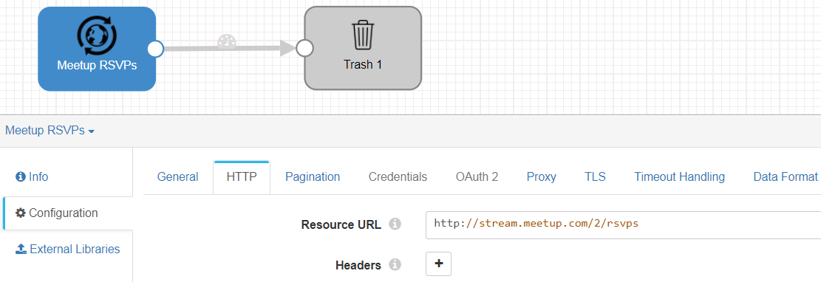
Step by step pipeline creation
http://stream.meetup.com/2/rsvps
Create a pipeline
Add Source & Destination(s)
Configure Stages
Optionally Add Parameters
Configure Pipeline Default Error

Slide 11
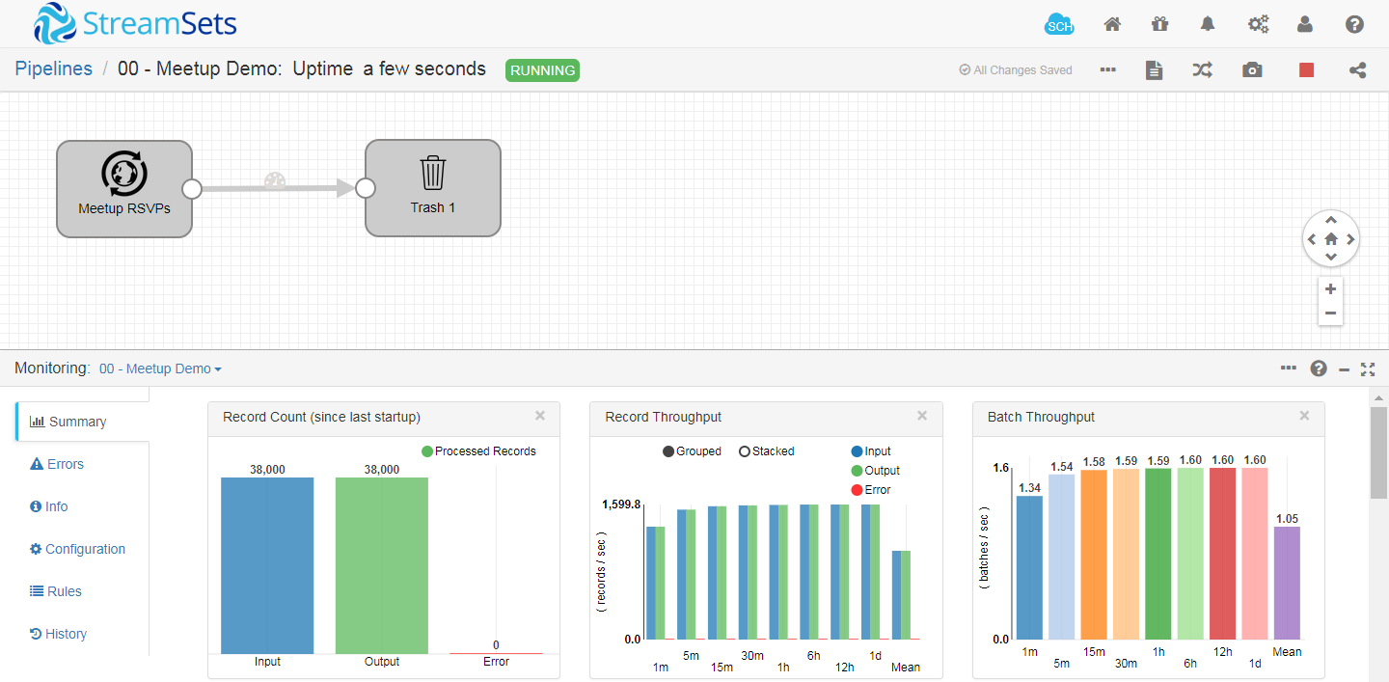
Running Pipelines
Notes:
Note that the record and batch throughput graphs are calculated using an exponential moving average, weighing more heavily toward the most recent values and exponentially reducing the effect of old data.

Slide 12
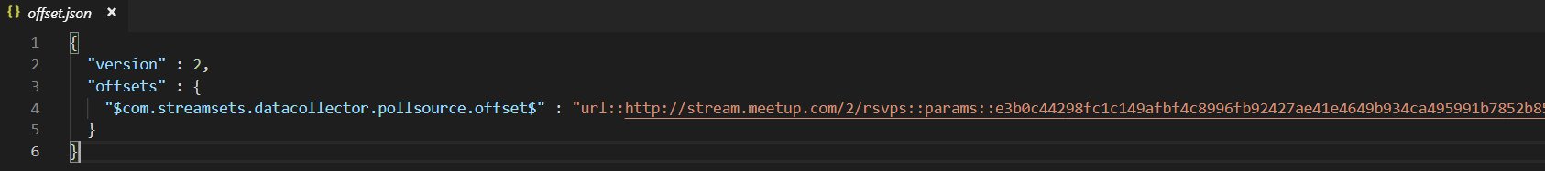
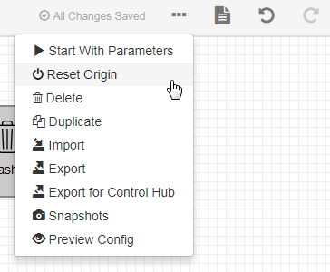
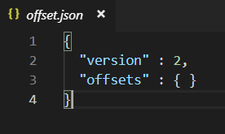
Resetting Origin
Each pipeline keeps track of the data that it has pull to date while running.
This information is stored in the runinfo directory inside “offset.json”
To force the pipeline to read data from the very beginning you need to reset the origin:

Slide 13
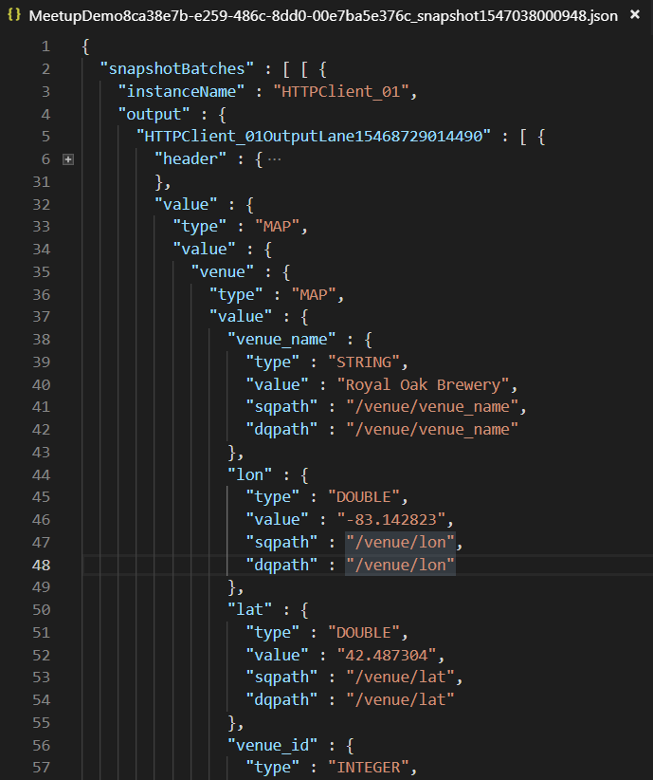
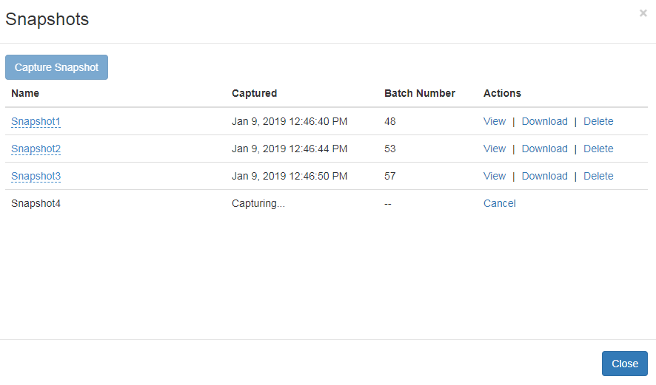
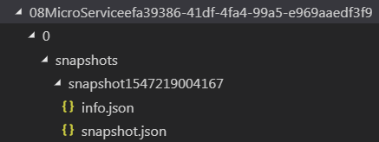
View Flowing Data - Snapshots
Snapshots are also stored in the runinfo directory:

Slide 14
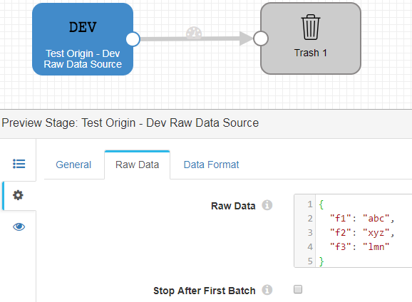
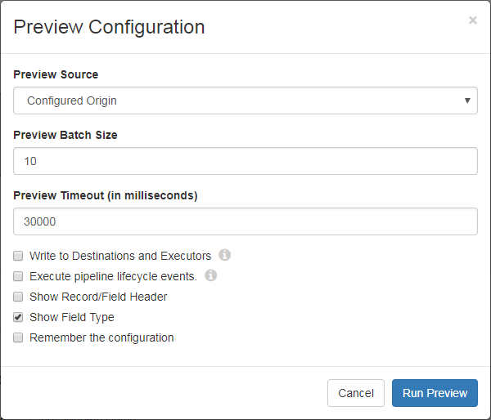
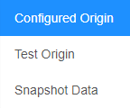
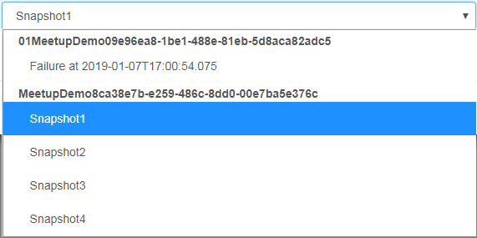
Running Previews – Configuration
Test Origin
You can preview data to help build or fine tune pipelines.
Snapshot Data
Write to Destinations and Executors
By default, data preview does not write data to destinations.
Show Record/Field Header
Some stages created record header attributes with useful metadata. I.e.: If reading from a directory with many files, every record will have a ‘filename’ attribute indicating the file that contained the record.

Slide 15
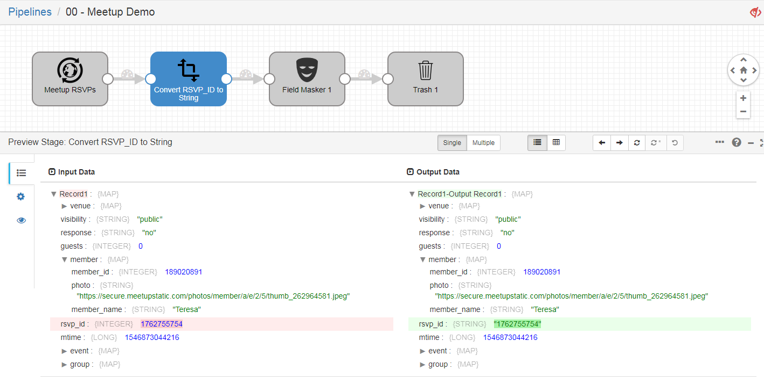
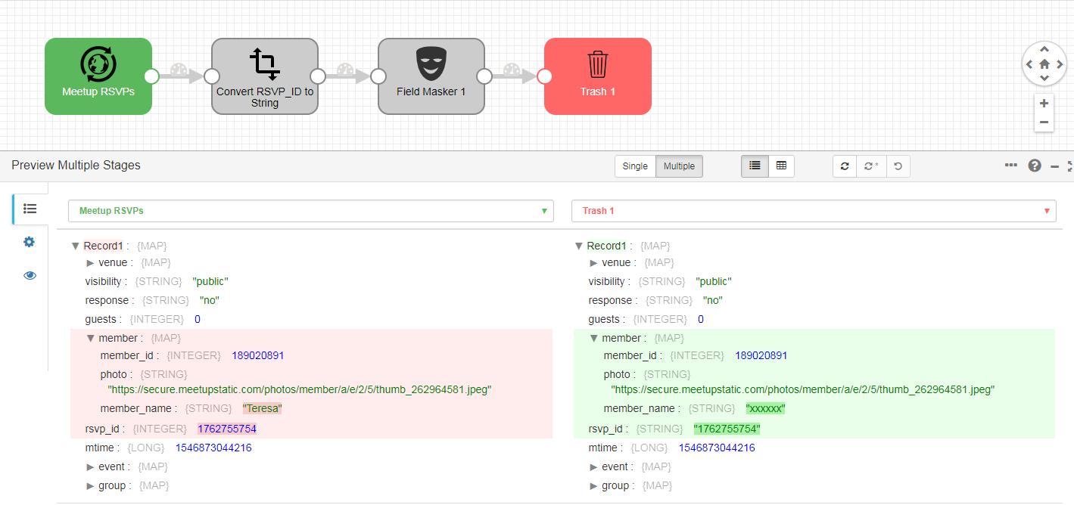
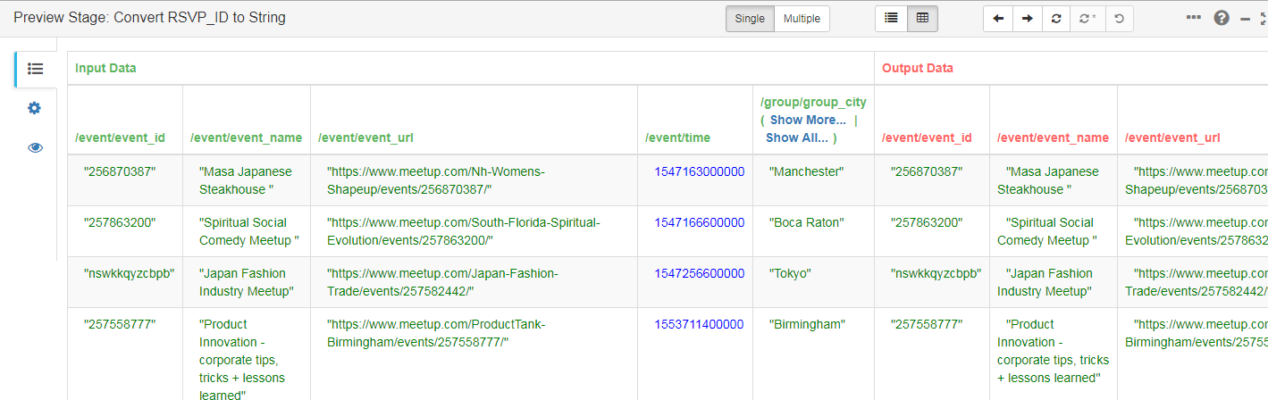
Running Previews – View Snapshots
Notes:
Black values: Date data
Blue values: Numeric data
Green values: String data
Red values: Boolean data
Asterisk: Records that include edited field values
Red italic field labels: Fields that contain edited data
Light red background: Fields removed by a stage
Italic values: Edited data

Slide 16
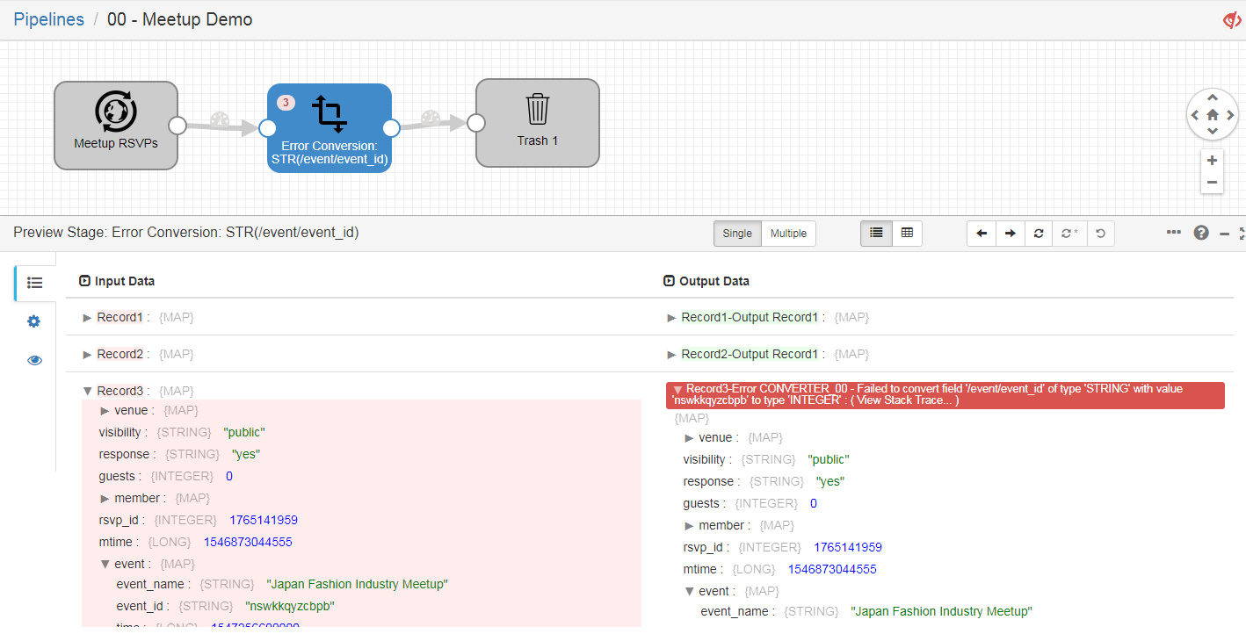
Error Handling

Slide 17
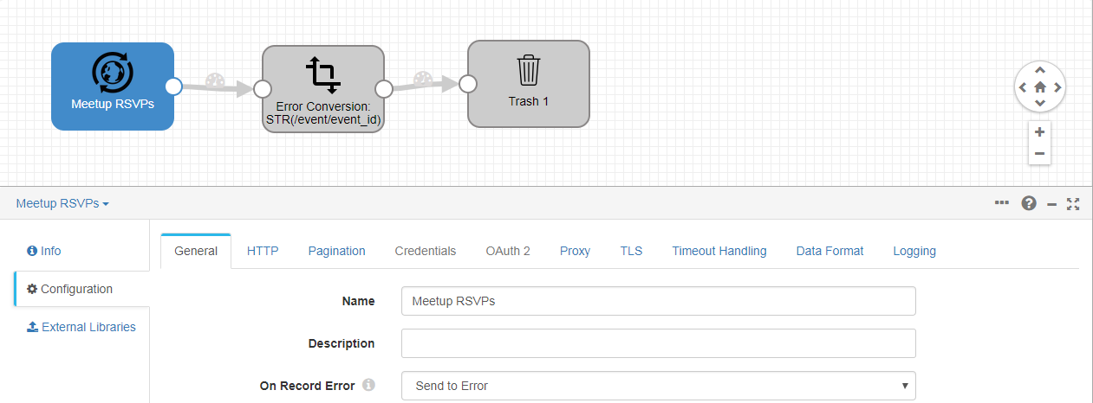
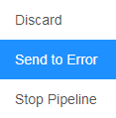
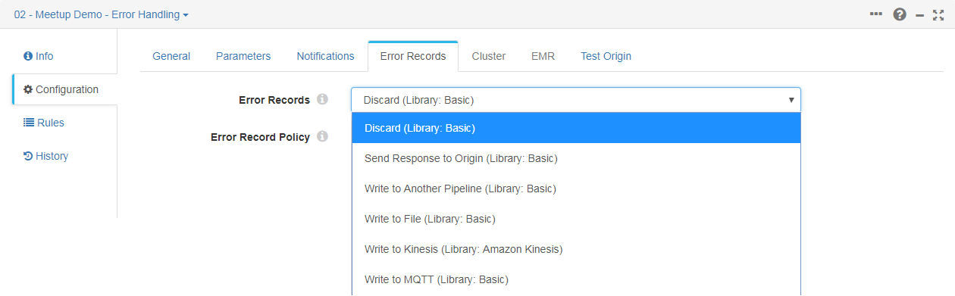
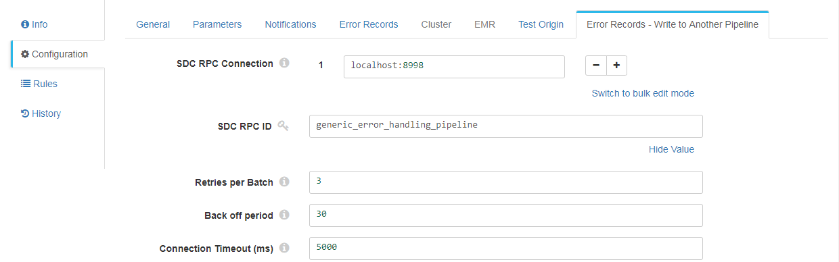
Error Handling - Configuration

Slide 18
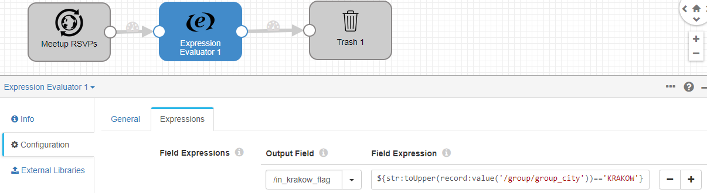
SDC Expression Language
StreamSets Expression language (based on JSP 2.0) provides the ability to dynamically configure, evaluate or modify data within pipelines.
The following elements can be specified in expressions:
Constants
Datetime Variables
Field Names
Functions
Literals
Operators
Runtime Parameters, Properties and Resources
https://bit.ly/2RG87EP
Notes:
JSP = Java Server Pages
Meetup = Jump to Slide 27

Slide 19
SDC Expression Functions
Function Type | Description | Common Examples
Record | To determine information about a record | ${record:value('/field_name’)} ${record:type('/field_name’)} ${record:exists('/field_name’)} ${record:id()}
Error Record | To determine information about error records | ${record:errorCode()} ${record:errorMessage()}
Credential | To retrieve a credential value from credential store systems such as CyberArk or HashiCorp Vault. | ${credential:get('jks', 'group', 'secret_name')}
Data Drift | To create alerts when data drift occurs within data drift rules | ${drift:names('/', true)} ${drift:type('/', false)}
Field | To use in in field path expressions in order to dynamically determine what field to process | /*[${f:type() == 'DATETIME’}] /*[${f:value() > 0}]
File | To return information about a file name or path | ${file:fileExtension('/logs/weblog.txt’)} ${file:parentPath('/serverB/logs/weblog.txt')}
Math | To perform math on numeric values | ${math:abs(-1234)}
Pipeline | To determine information about a pipeline | ${pipeline:name()} ${pipeline:startTime()}
String | To transform string data | ${str:concat(“Stream”, “Sets”)} ${str:contains("Jane", "boo")} ${str:indexOf("tomorrow", "row")}
Time | To return the current time or to transform datetime data | ${time:dateTimeToMilliseconds(time:now())} ${time:timeZoneOffset(record:value('/TZ'))}
Misc | … | ${sdc:hostname()}
Notes:
record:creator() → Returns the instance name of the stage that created the record, typically an origin stage.
${drift:names('/', true)} → To trigger an alert when any field name in the record changes and ignore empty records.
${drift:type('/’, false)} → To trigger an alert when any field name in the record changes and ignore empty records.

Slide 20
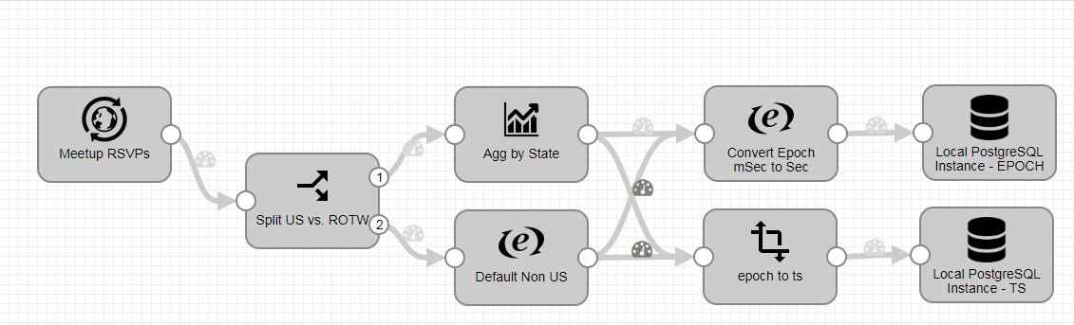
Branching, Splitting & Merging Streams
Branching
Connecting the same output of one stage to multiple target stages.
This operation duplicates the output.
Splitting
Redirecting the records to different inputs based on the evaluation of a logical condition.
Merging
Connecting the output of two or more stages into a single input of another stage.
This operation is equivalent to a UNION ALL in SQL-ANSI and it doesn’t eliminate duplicates.
Branching
Splitting
Merging

Slide 21
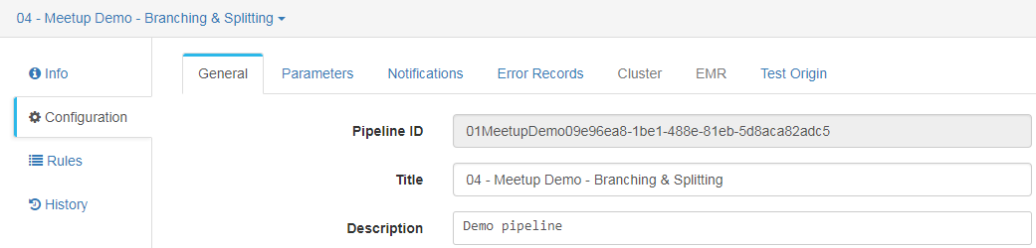
Pipeline Config - General
The pipeline configuration panel allows you to change specifics characteristics that define how the pipeline runs:
Configuration | Description
Execution Mode | Standalone * | A single SDC runs the pipeline.
 | Cluster Batch | The running SDC spawns additional workers as needed to process data in HDFS. Processes all available data and then stops the pipeline
 | Cluster YARN Streaming | The running SDC spawns additional workers as needed to process data. Use to stream data from Kafka / Spark Streaming on YARN.
 | Cluster Mesos Streaming | As above but from a Kafka cluster that uses Spark Streaming on Mesos.
 | Edge | For Edge pipelines.
Delivery Guarantee | Determines how Data Collector handles data after an unexpected event causing the pipeline to stop running.
 | At Least Once * | Ensures all data is processed and written to the destination. Might result in duplicate rows
 | At Most Once | Ensures that data is not reprocessed to prevent writing duplicate data to the destination. Might result in missing rows.
Start Event / Stop Event | Determines how the start/stop event are handled.
Retry Pipeline on Error / Retry Attempts | Whether to retry the pipeline upon error or not. / Number of retries attempted. Use -1 to retry indefinitely.
Max Pipeline Memory | Maximum amount of memory for the pipeline to use.
Create Failure Snapshot | Automatically creates a snapshot if the pipeline fails because of data-related errors. Can be used to troubleshoot the pipeline.

Slide 22
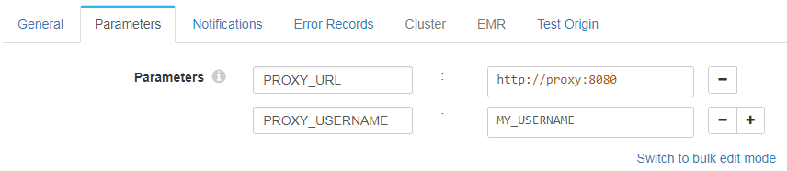
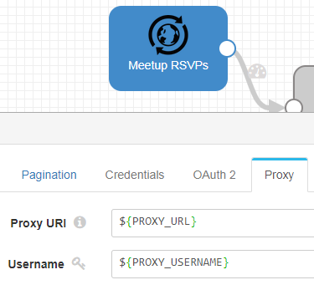
Pipeline Config – Runtime Parameters
Runtime parameters are parameters that you define in a pipeline and then call from within that same pipeline.
Use an expression to call a runtime parameter. You can use runtime parameters to represent any stage or pipeline property that allows the use of the expression language.

Slide 23
Event Generation
The event framework generates events for standalone pipelines when the pipeline starts and stops. You can pass the event to an executor or to another pipeline for additional processing.
Pipeline event records have the following event-related record header attributes.
Record Header Attribute | Description
sdc.event.type | Event Type: Either “start” or “stop”
sdc.event.creation_timestamp | Epoch timestamp when the stage created the event.
START
The event Framework generates start events as the pipelines initializes, immediately after it starts and before individual stages are initialized.
STOP
The event Framework generates stop events after all stages have completed processing and cleaning up temporary resources.

Slide 24
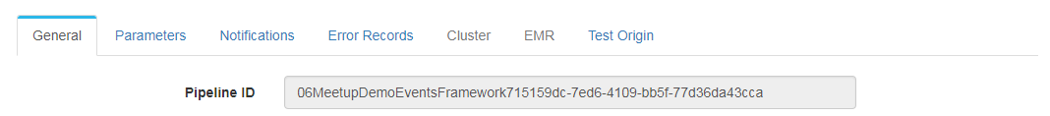
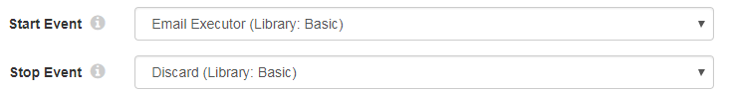
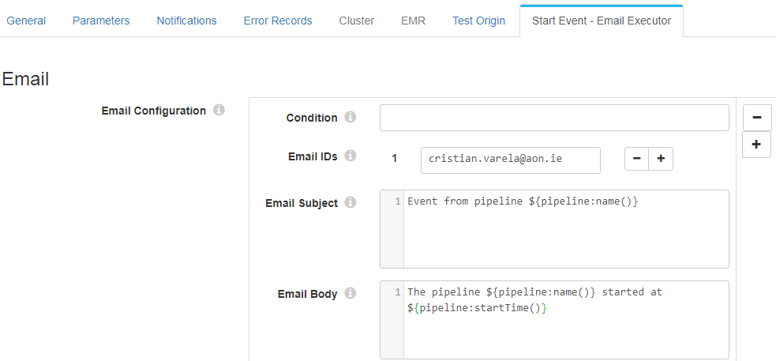
Events Framework – Pipeline Events
You can configure a pipeline to pass each event type to an executor stage configured within the Pipeline configuration

Slide 25
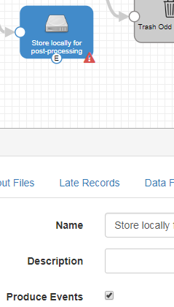
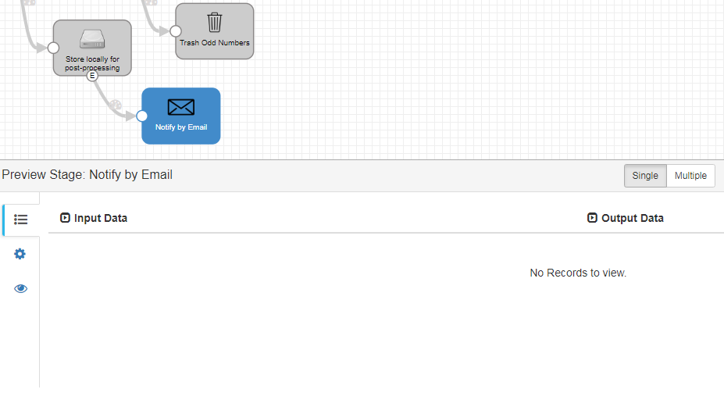
Events Framework – Stage Events
You can configure certain stages to generate events. Event generation differs from stage to stage, based on the way the stage processes data.
FILE CLOSURE
The destination creates a file closure event record when it closes and output file.
Header attribute field include:
filepath, filename, length
WHOLE FILE PROCESSED
The destination generates an event record when it completes streaming a whole file.
Header attribute field include:
sourceFileInfo, targetFileInfo, checksum
Notes:
Note that in the preview mode no records flow to the Executor.
Refer to the documentation to see what type of events the Origin / Destination generates.

Slide 26
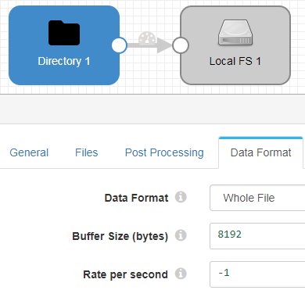
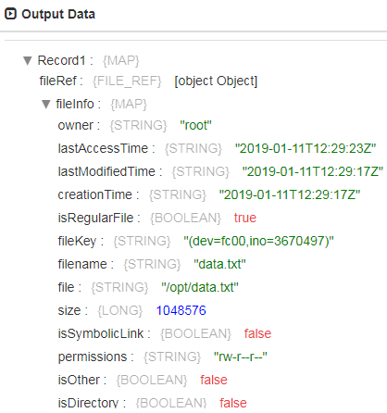
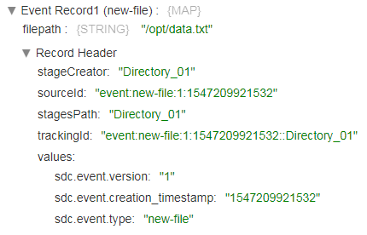
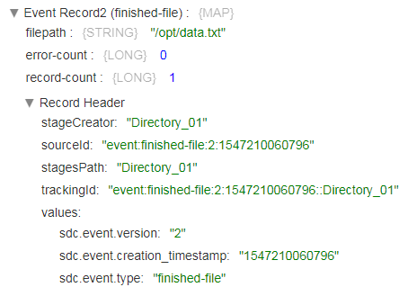
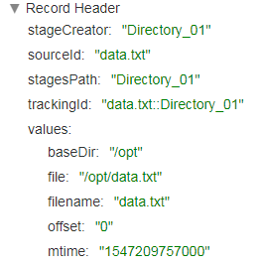
Whole File Processing
new-file
finished-file

Slide 27
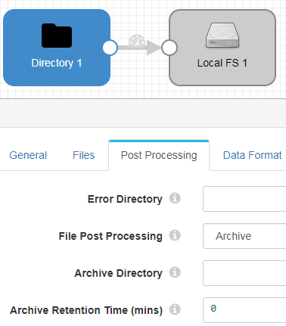
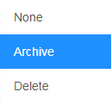
Whole File Post Processing
To specify what action to needs to be taken after processing a file:

Slide 28
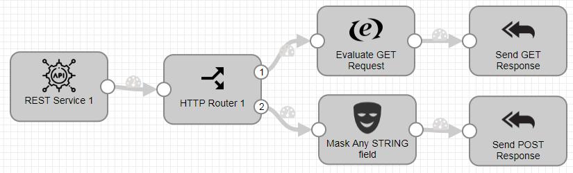
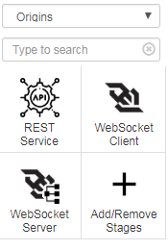

Microservice Pipelines
A microservice pipeline is a pipeline that creates a fine-grained service to perform a specific task.
Source | Description
REST Service | Listens on an HTTP endpoint, parses the content of all auth. Requests, and sends response back to the originating API.
WebSocket Client | Reads data from a WebSocket Server. Can send responses back to origin system.
WebSocket Server | Listens on a WebSocket endpoint and processes the contents of all auth. WebSocket Clietn requests.
Apart from the regular destinations being available as part of a microservice pipeline, the following microservice destinations can send responses to microservice origins.
Destination | Description
HTTP Client Dest. | Writes data to an HTTP endpoint.
Kafka Producer | Writes data to a Kafka Cluster.
Kinesis Producer | Writes data to a Kinesis Stream.
Send Response To | Sends Records with the specified response to the microservice origin in the pipeline.

Slide 29




Configuring & Using the Microservice Pipeline
When a microservice pipeline runs it automatically starts listening to the port (or WebSocket) of the origin waiting for requests.
Use the HTTP Client Processor to call a microservice pipeline. Note that it will produce a call per record. However is possible to pivot records to batch requests before the REST call.

Slide 30

RESTful API
Data Collectors have a fully feature RESTful API that allows you performing coming admin tasks programmatically:
http://127.0.0.1:18630/collector/restapi

Slide 31

Notifications
You can configure a pipeline to send an e-mail or write to a webhook when the pipeline changes to specified states:
To send email notifications, the email alert SDC properties must be configured by editing the $SDC_CONF/sdc.properties file

Slide 32



Alerts
Type of Rule | Description
Metric | Gathers statistics about the pipeline such as pipeline idle time or error record counts.
Data | Gathers details about data as it passes between two stages.
Data Drift | Gathers details about data drift as data passes between two stages.

Slide 33



Integration with Secrets Managers
Data Pipelines often need to read/write data from systems that require credentials which need to be entered in the configurations of the stages.
Hard-coding those credentials in the pipelines, expose their values to any users with access to those pipelines.
Alternatively you can use a secret manager to securely store and access those credentials such as:
Secrets Managers
Java Keystore
Hashicorp Vault
CyberArk
Microsoft Azure Key Vault
The Secret Manager needs to be configured in StreamSets and then it can be accessed by stagelib-cli commands & sdc functions:

Slide 34


Advanced Topic - Custom Stages - Jython
The Jython evaluator supports calling custom code to process data using Jython 2.7.x (as of SDC 3.7.0).
The are 3 separate scripts that you can configure:
Script | Description
Initialization | Optional Script to set up resources or connections required by the processor. Runs once when the pipeline starts.
Main Processing | Main Scripts that processes data. Runs for each record or each batch.
Destroy | Optionally destroy script and closes any resources or connections opened by the processor. Runs once when the pipeline stops.
EVENT Generation
There are functions to create events (createEvent) and send records to the Event output (toEvent)

Slide 35



Advanced Topic - RPC
RPC: Remote Protocol Calls enables a pipeline to pass data to another pipeline without writing to any intermediary system in the same machine, over the network or through the public internet (option to enable SSL/TLS).
The SDC RPC destination and SDC RPC origin enable you to pass data securely from one pipeline to another, effectively like creating a single pipeline that spans a network.

Slide 36


Advance Topics – RPC Patterns
Downstream Availability
Load Balancing & Redundancy

Slide 37



Advanced Topic – Installing Libraries
Install additional stage libraries to use stages that are not included in the core RPM or core tarball installation of Data Collector.
Go to package manager then in the settings click “SDC Directories”:
SSH into the SDC and in that directory you can run the commands:
bin/streamsets stagelibs

Slide 38





Enterprise Features
Pipeline Fragments
A pipeline fragment is a stage or set of connected stages that you can reuse in pipelines. Use pipeline fragments to easily add the same processing logic to multiple pipelines and to ensure that the logic is used as designed.

Slide 39

Code Examples and instructions
Examples from this presentation and further information available in GitHub
https://github.com/cvarelaruiz/StreamSets_SDC_Examples

